Slide 1


Build a Personalized Online Course Recommender System with Machine Learning
Omar Essam
October 24, 2026
Notes:
Capstone project of the IBM Machine Learning Professional Certificate, presented by Omar Essam on October 24, 2026.

Slide 2

Outline
Introduction and Background
Exploratory Data Analysis
Content-based Recommender System using Unsupervised Learning
Collaborative-filtering based Recommender System using Supervised learning
Conclusion
Appendix

Slide 3
Introduction
Project background and context
Problem statement and hypotheses
An online learning platform (IBM Skills Network) offers 307 courses in data science, AI, cloud, databases and software development.
Learners struggle to find the next relevant course in a large catalogue; a personalised recommender surfaces unseen courses that match each learner's interests and raises engagement and completion.
Data: course titles, descriptions and 14 genre tags, plus 233,306 enrollments with ratings from 33,901 learners.
Problem: recommend new, relevant courses to every learner, and find out which family of models - content-based (unsupervised) or collaborative filtering (supervised) - does it best.
H1: enrollments concentrate on a few popular, introductory courses and genres.
H2: content-based methods can keep the list of new courses per learner under 20 while still reaching most learners.
H3: latent-factor models (NMF, neural embeddings) predict ratings more accurately (lower RMSE) than KNN and a global-mean baseline.
307
courses
14
course genres
33,901
learners
233,306
enrollments (ratings)
Notes:
Background: a course platform with 307 courses needs to recommend relevant unseen courses to its learners. We test three hypotheses: H1 popularity concentration, H2 manageable content-based recommendation lists, H3 latent-factor collaborative filtering beats KNN and the baseline on RMSE.

Slide 4
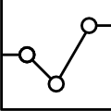
Exploratory Data Analysis

Slide 5
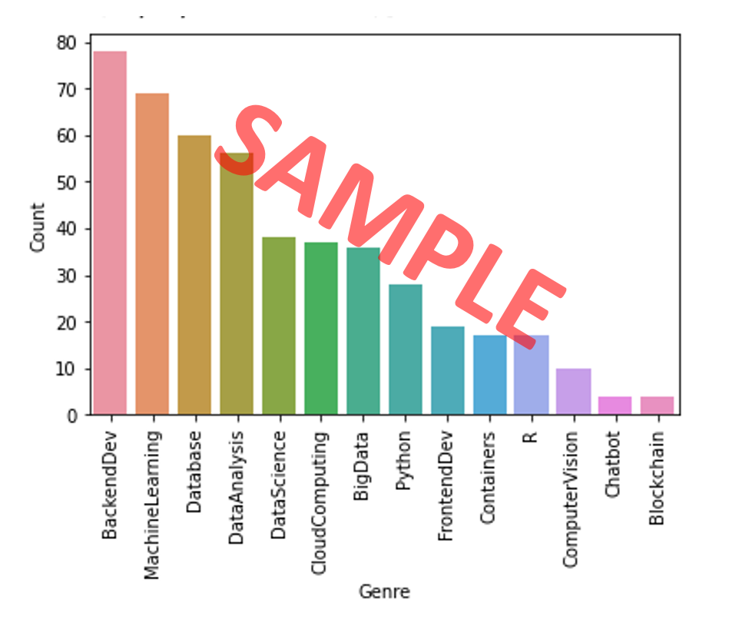
Course counts per genre
78
courses are tagged Backend Dev, the largest genre (25% of the 307 courses)
Backend Dev (78 courses) and Machine Learning (69) lead the catalogue, followed by Database (60) and Data Analysis.
Chatbot and Blockchain are niche, with 4 courses each.
A course can carry several genres: 473 tags over 307 courses (1.54 per course on average).
Notes:
Horizontal bar chart of the number of courses per genre, computed with course_df[genres].sum() and sort_values(). Backend development, machine learning and databases are the biggest genres; chatbot and blockchain the smallest.

Slide 6
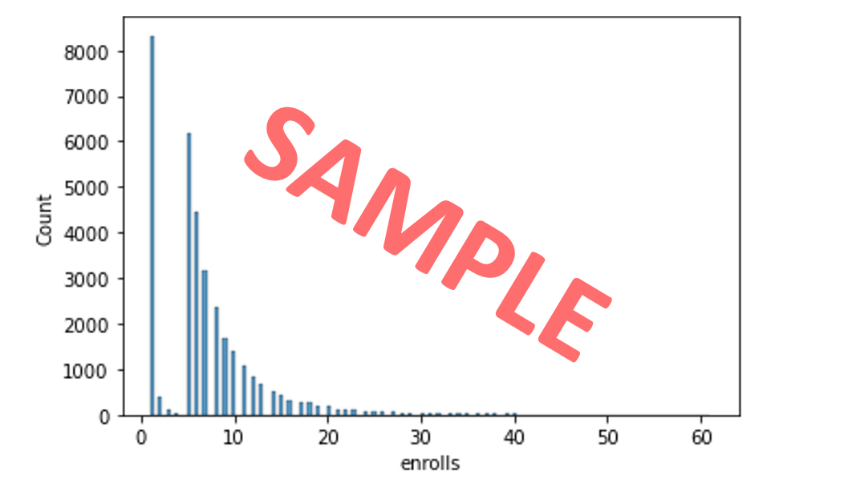
Course enrollment distribution
24.5%
of learners (8,320) enrolled in just one course
Mean 6.9, median 6, max 61 courses per learner (std 5.8).
The distribution is bimodal: very few learners have 2-4 courses (519), then a second peak at 5 courses (6,179) with a long tail.
One-course learners are a cold-start group: popularity or content-based recommendations suit them better than collaborative filtering.
Notes:
Histogram of the number of enrolled courses per user (groupby('user').size()). 8,320 users enrolled in a single course; the rest mostly enrolled in 5-12 courses. Learners with more than 30 courses are grouped into the last bar.

Slide 7
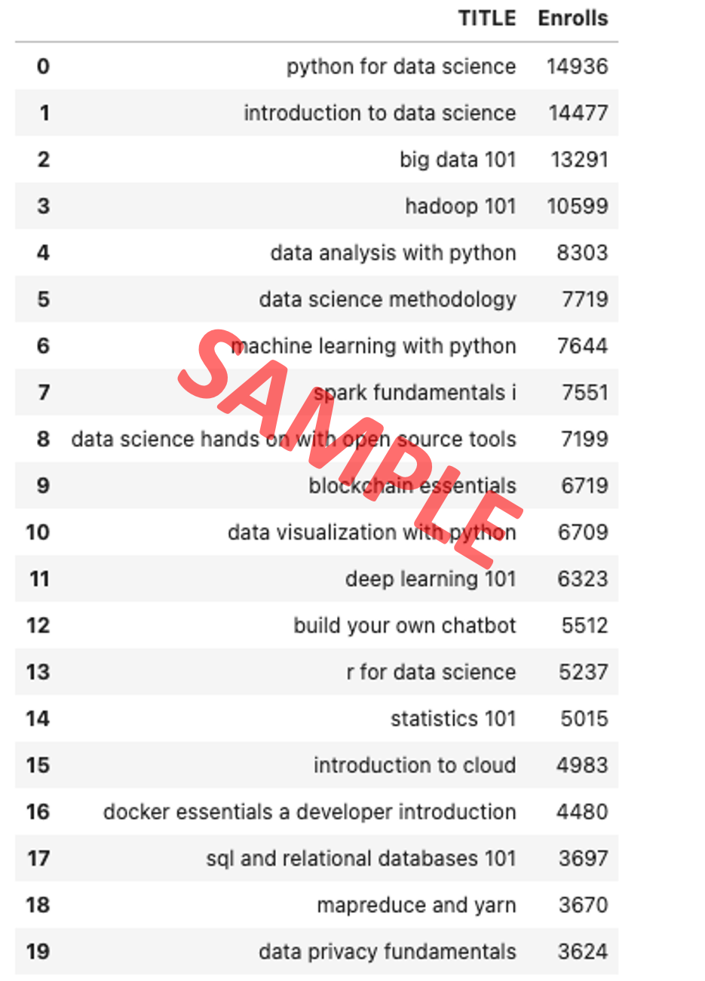
20 most popular courses
63.3%
of all 233,306 enrollments go to these 20 of 126 rated courses
Python for Data Science (14,936), Introduction to Data Science and Big Data 101 lead the list.
Almost all are introductory courses (101, Introduction, Fundamentals): learners start with foundations.
This popularity bias (H1 confirmed) means a recommender must work to surface less popular courses.
Notes:
The 20 most enrolled courses, from ratings_df.groupby('item').size() merged with course titles. Together they account for 63.3% of all enrollments.

Slide 8
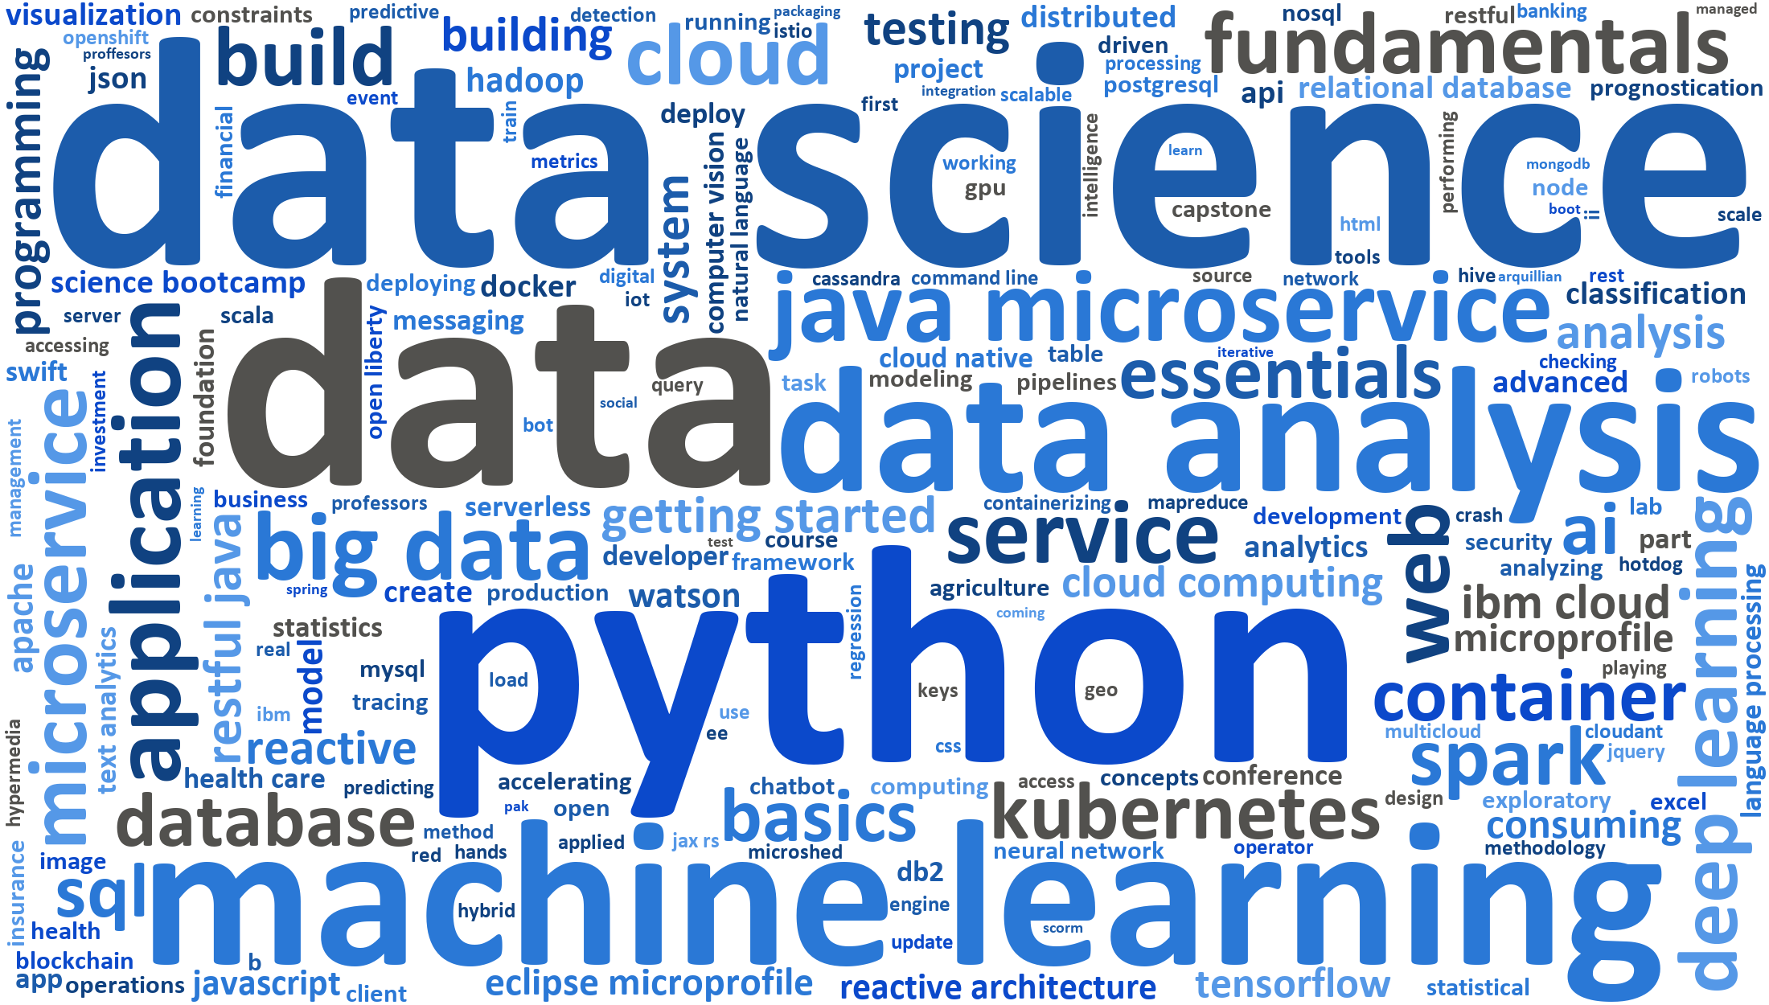
Word cloud of course titles
Most frequent title words
data (86), learning (31), science (30), cloud (29), python (27), analysis (27) - counted as the number of titles that contain the word.
What it tells us
The catalogue is built around in-demand IT skills: data science, Python, machine learning, cloud, big data, SQL and containers.
Title words overlap strongly between courses, so text features (bag of words) are a good basis for course similarity.
Notes:
Word cloud of all 307 course titles (wordcloud package, English stop words plus a few generic words removed). Larger words appear in more titles: data, python, science, machine learning, cloud and big data dominate.

Slide 9
Content-based Recommender System using Unsupervised Learning
Cluster2
Cluster1

Slide 10
Flowchart of content-based recommender system using user profile and course genres
1
2
3
4
Raw data
course_genre.csv, user_profile.csv, ratings.csv
Course genre vectors
14-d one-hot genre vector for each of the 307 courses
User profile vectors
14-d interest weights: ratings x genres of enrolled courses
Unseen courses
all courses minus the courses the user enrolled in
8
7
6
5
Evaluation
new courses per user and top-10 courses
Recommendations
USER, COURSE_ID, SCORE sorted by score
Threshold filter
keep unseen courses with score >= 20
Interest score
dot product of user profile and course genre vector
Course genre vectors (307 x 14) and user profile vectors (33,901 x 14) live in the same genre space, so a dot product measures how well a course matches a learner's interests.
Only unseen courses are scored; the score threshold controls list length - the lab default of 10 gave 44 courses per user, so it was raised to 20.
Evaluation follows the lab questions: average number of new courses per test user and the 10 most frequently recommended courses.
Notes:
The user profile is a weighted genre vector built from the user's ratings. Each unseen course gets a score equal to the dot product of the profile and the course genre vector; courses above the score threshold are recommended.

Slide 11
Evaluation results of user profile-based recommender system
Hyper-parameters: recommendation score threshold = 20 (dot product of user profile and course genres); thresholds 5-40 tested, chosen to keep lists under 20 courses.
Top-10 most frequently recommended courses
14.1
new/unseen courses recommended per test user on average (16,554 of 33,901 users receive at least one)
# | Course | Times
1 | Foundations for Big Data Analysis with SQL | 9,138
2 | Analyzing Big Data with SQL | 9,138
3 | Getting Started with the Data Apache Spark Makers Build | 8,954
4 | Analyzing Big Data in R using Apache Spark | 8,769
5 | Spark Overview for Scala Analytics | 7,970
6 | Cloud Computing Applications Part 2 Big Data and Applications in the Cloud | 7,853
7 | Applied Machine Learning in Python | 7,671
8 | Introduction to Data Science in Python | 7,671
9 | Accelerating Deep Learning with GPU | 7,633
10 | Spark Fundamentals II | 7,203
Average new courses per user by score threshold
Notes:
Results of the user-profile recommender on all 33,901 test users with score threshold 20. Left: average list length and its sensitivity to the threshold. Right: top-10 recommended courses.

Slide 12
Flowchart of content-based recommender system using course similarity
1
2
3
4
Raw data
course_processed.csv (titles + descriptions), ratings.csv
Text processing
NLTK: tokenize, drop stop words and numbers, keep nouns
Bag of words
gensim Dictionary + doc2bow: token counts per course
Similarity matrix
cosine similarity of BoW vectors, 307 x 307
8
7
6
5
Evaluation
new courses per user and top-10 courses
Recommendations
USER, COURSE_ID, SCORE sorted by similarity
Best match + threshold
keep the highest similarity; recommend if > 0.6
Enrolled vs unseen
similarity of each unseen course to each enrolled course
Each course is represented by the bag of words of its title and description (stop words removed, nouns kept), giving sparse token-count vectors.
Cosine similarity between BoW vectors measures content overlap; e.g. Machine Learning with Python vs Machine Learning with R = 0.66.
For every test user an unseen course is recommended when its best similarity to one of the user's enrolled courses exceeds 0.6.
Notes:
Course textual content becomes BoW feature vectors; the cosine similarity matrix between all courses is pre-computed. For each user, unseen courses that are similar enough to any enrolled course are recommended.

Slide 13
Evaluation results of course similarity based recommender system
Hyper-parameters: cosine similarity threshold = 0.6 on the BoW course similarity matrix (an unseen course must exceed it for at least one enrolled course); 0.4-0.8 tested.
Top-10 most frequently recommended courses
8.5
new/unseen courses recommended per test user on average (29,661 of 33,901 users receive at least one)
# | Course | Times
1 | Data Science with Open Data | 15,003
2 | Introduction to Data Science in Python (excourse22) | 14,937
3 | Introduction to Data Science in Python (excourse62) | 14,937
4 | A Crash Course in Data Science | 14,641
5 | Data Science Fundamentals for Data Analysts | 14,641
6 | Big Data Modeling and Management Systems | 13,551
7 | Foundations for Big Data Analysis with SQL | 13,512
8 | Fundamentals of Big Data | 13,291
9 | Introduction to Big Data | 13,291
10 | SQL Access for Hadoop | 12,497
Average new courses per user by similarity threshold
Notes:
Results of the course-similarity recommender with threshold 0.6: about 8.5 new courses per user. Lower thresholds explode the list length (0.4 gives 48 courses per user).

Slide 14
Flowchart of clustering-based recommender system
1
2
3
4
User profiles
user_profile.csv: 33,901 users x 14 genre interests
Standardise
StandardScaler: mean 0 and std 1 for every genre feature
PCA
9 components explain >= 90% of the variance
K-means
k = 8 from the elbow of the inertia curve
8
7
6
5
Evaluation
new courses per user and top-10 courses
Recommendations
popular courses of the user's cluster not yet taken
Popular per cluster
courses with >= 500 enrollments in the cluster
Label test users
join each user's cluster with the enrollments (ratings.csv)
K-means was first run on the 14 standardised features (elbow at k = 8), then on 9 PCA components that keep 90% of the variance.
Each cluster is a learning community; courses enrolled by many members of the community are its popular courses.
Popularity threshold = 500 enrollments within the cluster; the user's own courses are excluded from the recommendations.
Notes:
Users are grouped by their standardised (and PCA-reduced) profile vectors with K-means. Each cluster keeps a list of its popular courses; a user is recommended the popular courses of their cluster that they have not enrolled in.

Slide 15
Evaluation results of clustering-based recommender system
Hyper-parameters: PCA n_components = 9 (>= 90% variance), K-means k = 8 (elbow), popularity threshold = 500 enrollments per cluster; 100-1,000 tested, with and without PCA.
Top-10 most frequently recommended courses
13.7
new/unseen courses recommended per test user on average (33,381 of 33,901 users receive at least one)
# | Course | Times
1 | Blockchain Essentials | 26,721
2 | Data Science Hands on with Open Source Tools | 23,038
3 | Introduction to Cloud | 22,828
4 | Hadoop 101 | 22,824
5 | Deep Learning 101 | 22,653
6 | Data Science Methodology | 22,569
7 | Statistics 101 | 20,691
8 | Big Data 101 | 20,139
9 | Introduction to Data Science | 18,920
10 | Python for Data Science | 18,490
Average new courses per user, with and without PCA
Notes:
Results of the clustering recommender. The grouped bars compare K-means on the original features with K-means on the PCA components for several popularity thresholds.

Slide 16
Comparing the three content-based recommender systems
Metric | User profile + genres | Course similarity (BoW) | User clustering (PCA + K-means)
Avg new courses per user | 14.1 | 8.5 | 13.7
Learners reached (at least one course) | 16,554 (49%) | 29,661 (87%) | 33,381 (98%)
Catalogue coverage (distinct courses) | 280 of 307 (91%) | 63 of 307 (21%) | 50 of 307 (16%)
Total recommendations | 479,131 | 289,738 | 466,094
Innovative insight: the three content-based recommenders behave very differently
User clustering (PCA + K-means) reaches the most learners, and User profile + genres spreads recommendations over the widest part of the catalogue.
Clustering recommends what is already popular in a learner's group, so it reinforces the popularity bias seen in the EDA; similarity and profile methods expose more long-tail courses.
Only 2 courses appear in more than one top-10 list, so the methods are complementary: a hybrid (e.g. profile score re-ranked by similarity) is a natural next step.
Notes:
Side-by-side comparison of the three content-based recommenders on the same 33,901 test users: list length, reach, catalogue coverage and total volume.

Slide 17
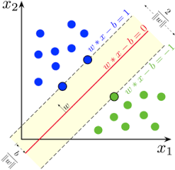
Collaborative-filtering Recommender System using Supervised Learning

Slide 18
Flowchart of KNN based recommender system
1
2
3
4
Enrollment history
ratings.csv: 233,306 (user, course, rating 3-5)
Surprise dataset
Reader(rating_scale=(3, 5)); 70% train / 30% test split
Item-item similarity
cosine, MSD or Pearson between course rating vectors (126 x 126)
k nearest neighbours
the k most similar courses that the user has rated
8
7
6
5
Recommend
unseen courses with the highest predicted rating
Baseline check
compare with the global-mean RMSE (0.8172) on the same test set
Evaluate + tune
test RMSE; grid search similarity x k (best: cosine, k = 40)
Predict rating
similarity-weighted average of the user's ratings of those neighbours
Item-based KNN: the course-course similarity matrix is tiny (126 x 126), while a user-based model would need a 33,901 x 33,901 matrix.
Prediction: r(u, i) = sum of sim(i, j) x r(u, j) / sum of sim(i, j) over the k most similar courses j rated by u; grid search over cosine / MSD / Pearson and k = 10-80.
Best: cosine, k = 40, test RMSE 0.8955 vs 0.8172 for the global mean (ratings.csv carries no signal - see findings). Lab fix: Reader scale (3, 5) instead of (2, 3).
Notes:
Item-based KNN collaborative filtering with the Surprise library: course-course similarities from the rating matrix, predictions as the similarity-weighted average of the user's ratings of the k most similar courses, evaluated by RMSE on a held-out test set.

Slide 19
Flowchart of NMF based recommender system
1
2
3
4
Enrollment history
ratings.csv: 233,306 (user, course, rating 3-5)
User-item matrix
33,901 x 126 sparse matrix; same 70/30 split as KNN
Factorise
R ~ U x I^T with non-negative user (U) and item (I) factor matrices
Train with SGD
minimise squared error on the known ratings; k = 8-64 factors
8
7
6
5
Recommend
unseen courses with the highest predicted rating
Baseline check
compare with the global-mean RMSE (0.8172) on the same test set
Evaluate + tune
test RMSE; grid search factors x epochs x init (best: 16 factors, 20 epochs)
Predict rating
dot product of the user's and the course's latent factors
NMF compresses the 33,901 x 126 rating matrix into k latent factors per user and per course, so no large similarity matrix has to be kept in memory; factors are learned by SGD on the observed ratings only.
The lab's hint (init_high = 5) starts the factor dot products far above 5, so every prediction is clipped to 5 (RMSE 1.2806); the default init range (0, 1) was added to the grid.
Best: 16 factors, 20 epochs, init (0, 1) - test RMSE 0.9505 vs 0.8172 for the global mean, on the same test ratings as KNN.
Notes:
Non-negative matrix factorisation: the sparse user-item matrix is decomposed into two small dense non-negative matrices of latent user and course features; their dot product estimates unknown ratings.

Slide 20
Flowchart of Neural Network Embedding based recommender system
1
2
3
4
Enrollment history
ratings (m03 lab 05).csv: 233,306 (user, course, rating 2 or 3)
Encode + scale
user and course ids to indices; ratings scaled to 0-1; 80/10/10 split
Embedding layers
user (33,901 -> 16-d) and course (126 -> 16-d) embeddings + biases
Interaction
dot product of the embeddings + user bias + course bias -> ReLU
8
7
6
5
Latent features
user and course embeddings reused for regression / classification
Improve: V2
per-example dot product + dense layer, early stopping: RMSE 0.0740
Evaluate
test RMSE 0.1192 vs 0.2085 for the global mean
Train
Adam, MSE loss, batch 64, 10 epochs, validation loss monitored
The one-hot user and course inputs are mapped to dense 16-d embedding vectors - the neural counterpart of the NMF factor matrices.
Finding: the lab's tf.tensordot(user, item, 2) sums the dot products over the whole batch. RecommenderNetV2 (per-example dot product + dense layer) cuts the test RMSE to 0.0740.
The embedding matrices (33,901 x 16 and 126 x 16) are the extracted latent features used by the regression and classification labs.
Notes:
RecommenderNet: two embedding layers learn latent user and course vectors whose dot product (plus bias terms) predicts the rating. The trained embeddings are extracted and reused as features for regression and classification models.

Slide 21
Embedding features: regression and classification results
Regression: predict the rating score
Classification: predict the rating class (3 / 4 / 5)
Model | Best hyper-parameters | Test RMSE
Lasso | alpha: 0.001 | 0.8138
ElasticNet | alpha: 0.001, l1_ratio: 0.5 | 0.8138
Global-mean baseline | - | 0.8138
Ridge | alpha: 100 | 0.8138
LinearRegression | - | 0.8138
HistGradientBoosting | learning_rate: 0.05, max_depth: 3 | 0.8138
Model | Accuracy | Macro F1 | AUC (OvR)
Bagging (trees) | 0.336 | 0.332 | 0.500
Logistic Regression | 0.335 | 0.327 | 0.500
Linear SVM | 0.335 | 0.327 | -
Gradient Boosting | 0.333 | 0.326 | 0.499
Random Forest | 0.335 | 0.324 | 0.503
Decision Tree | 0.330 | 0.215 | 0.500
Majority-class baseline | 0.329 | 0.165 | 0.500
Input X = user embedding + course embedding (element-wise sum, 16 features) for every rating of ratings.csv; label y = rating score / class.
Best regressor: Lasso (RMSE 0.8138 vs 0.8138 for the global mean); best classifier: Bagging (trees) (accuracy 0.336 vs 0.329 for the majority class, macro F1 0.332).
Every regressor matches the global mean and every classifier sits at chance (AUC about 0.50): the 3/4/5 ratings of ratings.csv are random, so there is no signal to learn (see findings).
Notes:
Regression and classification labs: embedding features from the neural network are aggregated and fed to scikit-learn models. Models were tuned with 3-fold grid search (regression) and compared with naive baselines.

Slide 22
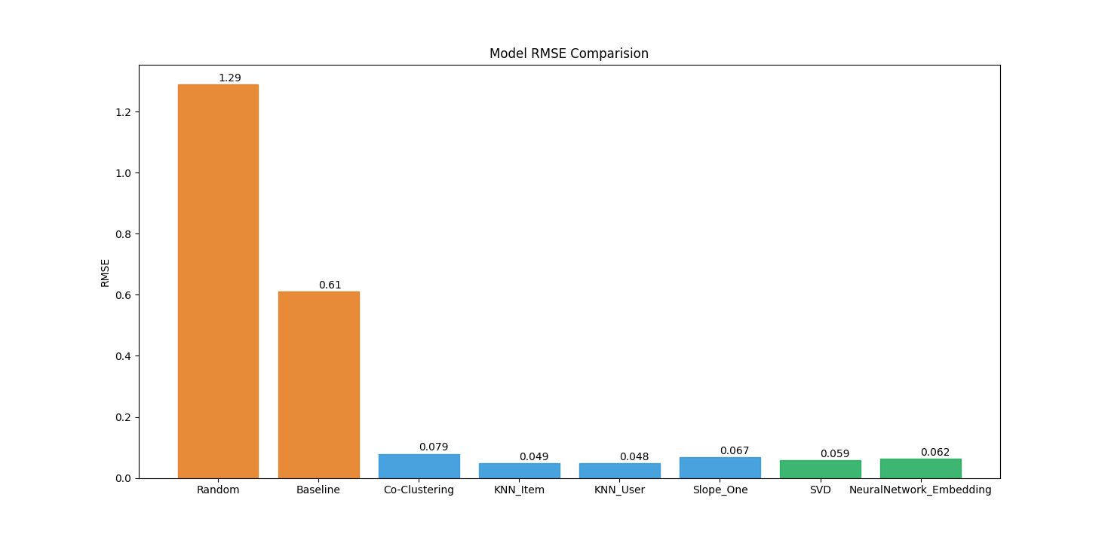
Compare the performance of collaborative-filtering models
Lab-05 ratings (2/3): the file with real signal
test RMSE, same 70/30 split for every model, rating units, lower is better
ratings.csv (3/4/5): random ratings
test RMSE, same 70/30 split for every model, rating units, lower is better
Signal file: RecommenderNetV2 is best (0.1048, 50% below the global mean 0.2104), then the lab RecommenderNet (0.1517); KNN and NMF improve 8% and 8%; untuned SVD (100 factors) overfits.
ratings.csv: the ratings are random, so the global mean (0.8138) is the best possible score; models that fit noise score worse. Lab runs agree: KNN 0.8955 and NMF 0.9505 vs baseline 0.8172.
Metric: RMSE = square root of the mean squared difference between predicted and true ratings on held-out data - the evaluation metric of every collaborative-filtering lab.
Notes:
Every collaborative-filtering model was retrained in m03/08 on one identical split per rating file, so the RMSEs are directly comparable. Gray bar: global-mean baseline; dark blue: best model. RMSE (root mean squared error) is the evaluation metric of all collaborative-filtering labs.

Slide 23
Conclusions
Key findings
H1 confirmed: the top-20 courses take 63% of all enrollments, and 25% of learners took a single course.
H2 confirmed: after tuning, the profile, similarity and clustering recommenders suggest 14.1, 8.5 and 13.7 new courses per learner, reaching 49%, 87% and 98% of learners.
H3 confirmed where the data has signal: RecommenderNetV2 cuts RMSE by 50% vs the global mean and beats KNN and NMF. On ratings.csv, whose ratings are random, no model beats the mean (0.814).
Data checks and tuning matter as much as the model: default thresholds gave 41-44 courses per learner, and a randomised rating file makes every model look broken.
Recommendations
Serve new and one-course learners with content-based recommendations (profile or similarity): they need no rating history.
Use the neural embedding model for learners with history, with item-based KNN as a simple, explainable fallback.
Blend both in a hybrid ranker, cap lists with a per-user top-N (10-20), deduplicate course versions and add diversity for long-tail courses.
Next: ranking metrics (precision@k, recall@k) on a time-based split, then an A/B test of click-through and completion.
Bottom line: start every learner with content-based recommendations, switch to the neural embedding model once they have a rating history, and judge every model against a baseline on validated data.
Notes:
Summary of the findings against the three hypotheses and the recommended next steps.

Slide 24
Appendix
Lab notebooks
11 labs solved and executed: m01/06, 07, 10 (EDA, bag of words, similarity); m02/03, 05, 06 (profile, similarity, clustering); m03/03-07 (KNN, NMF, neural network, regression, classification).
Benchmark notebook
m03/08 - Extra - Benchmark of Collaborative Filtering Models.ipynb retrains KNN, NMF, SVD, both neural networks and Ridge on one identical 70/30 split of each rating file.
Results
results/*.csv - the small summaries each notebook exports (threshold sweeps, top-10 lists, RMSE tables). Every number in this deck is read from them.
Report source
m05/Final Project Submission/source: build_report.py fills the course template from the results; export_pdf.ps1 saves this PDF with PowerPoint.
Environment
Python 3.11, pandas 2.2, scikit-learn 1.5, scikit-surprise 1.1.4, TensorFlow 2.17 (Keras 3), gensim 4.3, NLTK 3.9, wordcloud 1.9, python-pptx 1.0.
Key code: profile scoring
# interest score of every course
# for every learner, vectorised
scores = profiles @ genres.T
scores = scores.mask(enrolled)
recs = scores >= 20
recs.sum(axis=1).mean() # 14.1
Notes:
All project assets live in the capstone folder of the course repository.

Slide 25
Appendix: hyper-parameter tuning
KNN: test RMSE by similarity and k (cosine and MSD overlap)
NMF: test RMSE by factors, epochs and initialisation range
K-means elbow (k = 8 raw, 8 on PCA)
PCA: accumulated explained variance (9 components >= 90%)
Notes:
Hyper-parameter searches behind the selected settings: KNN similarity and k, NMF factors and epochs, the K-means elbow and the PCA variance curve.

Slide 26
Appendix: data-quality findings
ratings.csv has random ratings
It holds the same 233,306 (user, course) pairs as the lab-05 file, but its ratings are spread evenly (3: 33.4%, 4: 33.4%, 5: 33.2%) and uncorrelated with the lab-05 ratings (r = -0.003). No model can beat the global mean on it; the benchmark retrains every model on both files.
Rating scale in the KNN / NMF labs
The labs read ratings.csv with Reader(rating_scale=(2, 3)); Surprise clips predictions to that range, so every estimate would be 3. Fixed to (3, 5).
NMF initialisation in the lab hint
init_low = 0.5, init_high = 5 makes the initial factor dot products far larger than 5, so after 20 epochs every prediction is clipped to 5 (RMSE 1.2806). The default range (0, 1) was added to the grid search.
Batch-wide dot product in RecommenderNet
tf.tensordot(user_vector, item_vector, 2) contracts both axes, so every example in a batch gets the same interaction term. RecommenderNetV2 (per-example dot product + dense layer): test RMSE 0.0740 vs 0.1192.
Default thresholds give long lists
Score threshold 10 recommended 44 courses per learner and popularity threshold 100 about 41; every threshold was swept and set to stay under the 20-course guideline.
Duplicate course versions
9 course pairs have identical text (similarity 1.0), e.g. Deep Learning with TensorFlow (ML0120EN / ML0120ENv2). They take slots in the top-10 lists and can recommend a course the learner already took under another id.
Notes:
Issues found while solving the labs, and how each was handled. Also fixed: the lab helper generate_sparse_bow() marks only one course's own tokens, so any two courses got cosine 1.0; the solution builds both vectors over the shared vocabulary (cosine 0.75).

